Slide 1
Android Development
Service

Slide 2
Agenda
Service Overview
Process and Thread in Android
Intent and Intent Filter in Android
Started Service and Bound Service
System Service

Slide 3
What Service
In the context of service-orientation and service-oriented architecture, the term service refers to a set of related software functionalities that can be reused for different purposes, together with the policies that should control its usage.
Service as "a mechanism to enable access to one or more capabilities, where the access is provided using a prescribed interface and is exercised consistent with constraints and policies as specified by the service description."

Slide 4
Different Services in Different Context
Local implementations in software
--Daemon, a background computer program in Unix
--Windows service, a background computer process belonging to no user in a Microsoft Windows system
Telecommunications service
--Web service, a software system to support interaction over a network
Value-added service or content service provided by communication service provider
--Services of an Intelligent Network (IN), for telecommunications, such as GSM services
--Web hosting service
--Software as a service (SaaS)

Slide 5
What Android Service Component
A Service is an application component representing an application's desire
#1 To perform a longer-running operation while not interacting with the user
#2 To supply functionality for other applications to use

Slide 6
FAQ about Android Service
Q: Is a Service a Separate Process?
A: The Service object itself does not imply it is running in its own process; unless otherwise specified, it runs in the same process as the application it is part of by default
Q: Is a Service a Thread?
A: It is not a means itself to do work off the main thread (to avoid Application Not Responding errors).

Slide 7
Agenda
Service Overview
Process and Thread in Android
Intent and Intent Filter in Android
Started Service and Bound Service
System Service

Slide 8
What Context
In computer science, a task context (process, thread ...) is the minimal set of data used by this task that must be saved to allow a task interruption at a given date, and a continuation of this task at the point it has been interrupted and at some future date.

Slide 9
What Process
In computing, a process is an instance of a computer program that is being executed. It contains the program code and its current activity.
A process MAY be made up of multiple threads of execution that execute instructions concurrently
Processes are often called "tasks" in embedded operating systems. The sense of "process" (or task) is "something that takes up time", as opposed to 'memory', which is "something that takes up space“.

Slide 10
What Multitasking
Each CPU executes a single task at a time.
Multitasking allows each Processor to switch between Tasks that are being executed without having to wait for each task to finish
By apply for time-sharing in OS with single processor, the execution of multiple processes seemingly simultaneously is called Concurrency.
For security and reliability reasons most modern OS prevent direct communication between independent processes, providing strictly controlled IPC functionality, such as Permission applied in Android

Slide 11
What Thread
A thread of execution is the smallest sequence of programmed instructions that can be managed independently by an OS scheduler
In most cases, a thread is contained inside a process
Multiple threads can exist within the same process so as to share resources such as memory, vice verse
The threads of a process share the latter's Context (the values that its variables reference at any given moment)

Slide 12
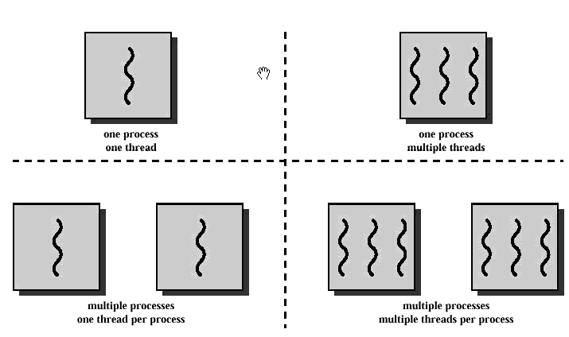
Process and Thread Conceptual Combination

Slide 13
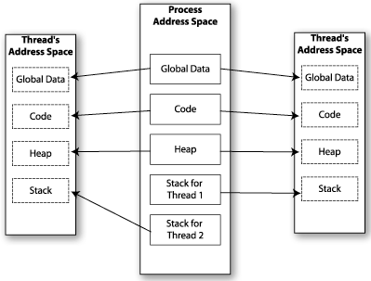
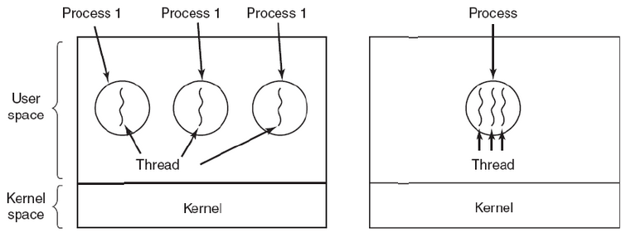
Process and Thread Address Space

Slide 14
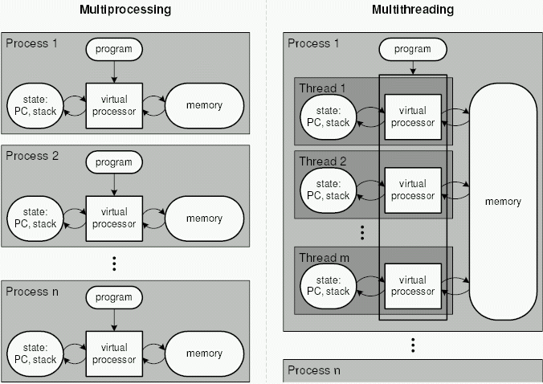
Multiprocessing and Multithreading

Slide 15
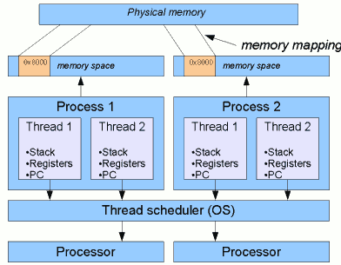
Process and Thread from OS perspective

Slide 16
Process in Android
When an application component starts and the application does not have any other components running, the Android system starts a new Linux process for the application with a single thread (Main thread / UI thread) of execution by default.
--Foreground process: user interact with
--Visible process: onPause due to dialog popup
--Service process: background, such as playing music
--Background process: onStop, system kill it at any time
--Empty process: hold nothing of application, cache

Slide 17
Process Lifecycle in Android
Process
Foreground process
Visible process
Service Process
Background Process
Empty Process
Broadcast Receiver
Service
Activity
In onCreate
onResume Called
In onReceive
In onStartCom
onPause Called
In onDestroy
onStop Called
Bound to user interacting activity
Bound to visible activity
component
After onStartCom

Slide 18
Thread in Android
When an application is launched, the system creates a thread of execution for the application, called "main."
It is in charge of dispatching events to the appropriate user interface widgets, including drawing events.
It is also the thread in which your application interacts with components from the Android UI toolkit (such as android.widget and android.view packages)
The main thread is also sometimes called the UI thread.

Slide 19
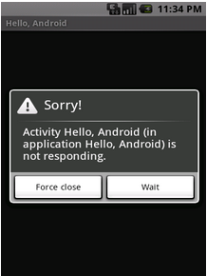
What ANR
In Android, the system guards against applications that are insufficiently responsive for a period of time by displaying a dialog to the user, called the Application Not Responding (ANR) dialog
For example: If an application blocks on some I/O operation (frequently a network access), then the main application thread won't be able to process incoming user input events.

Slide 20
What Trigger ANR Happen
KeyDispatchTimeout (5 seconds) – Most Case
--No response to an input event (e.g. key press, screen touch) within the specified time
BroadcastTimeout (10 seconds)
--A BroadcastReceiver hasn't finished executing within the specified time
ServiceTimeout (20 seconds)
--Service didn’t finish executing within the specified time

Slide 21
ANR Model
Application Process
System Process
Main Thread
MessageQueue
Activities
Detect TO
InputDispatcher Thread
Get message (if no msg, wait)
Services
(usually just one)
Detect TO
Handle Message
TO: Time Out
ActivityManager
Thread
Detect TO
Process
Broadcast Receivers
Thread
Component

Slide 22
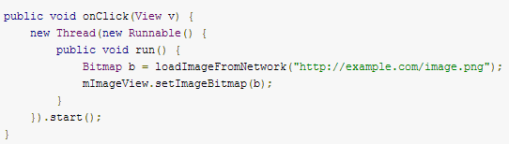
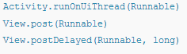
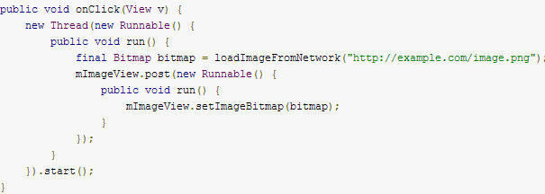
Solution to Fixed ANR Problem #1
A common solution to this problem is providing an I/O API that implements a synchronous interface by using non-blocking I/O internally, and scheduling another user thread or fiber while the I/O operation is in progress
--In Android it is named as Worker Thread
the Andoid UI toolkit is NOT thread-safe

Slide 23
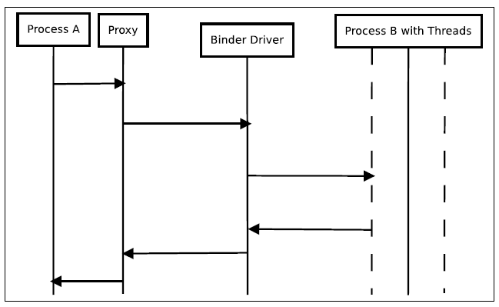
What Thread-safe
Thread safety is a computer programming concept applicable in the context of multi-threaded programs
A piece of code is thread-safe if it only manipulates shared data structures in a manner that guarantees safe execution by multiple threads at the same time.
For example in Android:
IBinder methods must, therefore, be implemented to be thread-safe, so methods of service must be thread-safe

Slide 24
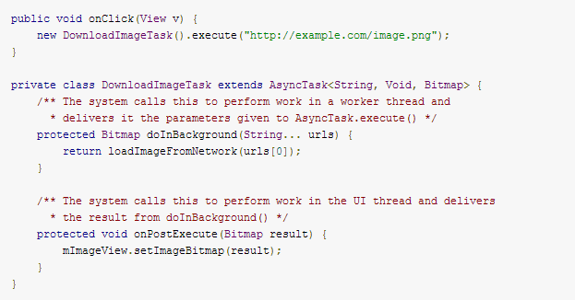
Solution to Fixed ANR Problem #2
AsyncTask allows you to perform asynchronous work on your user interface. It performs the blocking operations in a worker thread and then publishes the results on the UI thread, without requiring you to handle threads and/or handlers yourself.

Slide 25
Best Practice for Android Single Thread Model
#1 Do NOT block the UI thread
--Result in ANR
#2 Do NOT access the Android UI toolkit from outside the UI thread
--Result in Exception

Slide 26
Agenda
Service Overview
Process and Thread in Android
Intent and Intent Filter in Android
Started Service and Bound Service
System Service

Slide 27
What Intent
The HTTP protocol uses a number of <Action, resource> pairs to
accomplish its work, such as POST, GET, etc.
Android uses a mechanism quite similar to HTTP for the invocation of
work to be done, that is INTENT which is the Android’s name for the
abstraction requesting actions.
Unlike HTTP a given Android’s INTENT could be resolved in more than
one potential way (for instance, we may have several SMS apps
wanting to process an incoming text-message).
The primary pieces of information in an intent are: action & data

Slide 28
Composition of Intent
Parameter | Description
ACTION | A string naming the action to be performed, such as ACTION_XX
DATA | The URI of the data to be acted on and the MIME type of that data, such as vnd.android.cursor.item/vnd.google.note
Category | CATEGORY_LAUNCHER: initial activity of a task CATEGORY_DEFAULT: required for all filters, except for those with the MAIN action and LAUNCHER category
Extras | The Intent object has a series of put...() methods for inserting various types of extra data and a similar set of get...() methods for reading the data.
Flags | Many instruct the Android system how to launch an activity, and how to treat it after it's launched, such as FLAG_XX, such as FLAG_ACTIVITY_NEW_TASK

Slide 29
What Intent Resolution
When Intents are issued, Android looks for the most appropriated way of responding to the request.
Explicit Intents specify a particular component
( via setComponent(ComponentName) or setClass(Context, Class) ), which provides the exact class to be run.
Implicit Intents do not specified a particular component. However they include enough information for the system to determine which of the available components are in the is best category to run for that intent.

Slide 30
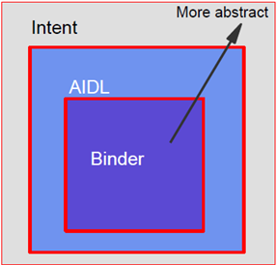
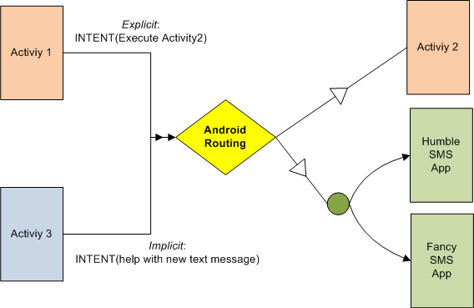
How Intents are Resolved
if (sendIntent.resolveActivity(getPackageManager()) != null) { startActivity(sendIntent); }
The intent resolution mechanism basically revolves around matching an Intent against all of the <intent-filter> descriptions in the installed application packages

Slide 31

Intent & Intent Filter Sample
<?xml version="1.0" encoding="utf-8"?>
<manifest xmlns:android="http://schemas.android.com/apk/res/android"
package=“com.dummy.app" android:versionCode="1" android:versionName="1.0.0">
<uses-permission android:name="android.permission.RECEIVE_SMS" />
<application android:icon="@drawable/icon" >
<activity android:name=".DummyActivity" >
<intent-filter>
<action android:name="android.intent.action.MAIN" />
<category android:name="android.intent.category.LAUNCHER" />
</intent-filter>
</activity>
<receiver android:name=“DummyReceiver" android:enabled="true" >
<intent-filter>
<action android:name="android.provider.Telephony.SMS_RECEIVED" />
</intent-filter>
</receiver>
<service>
……
……
</service>
</application>
</manifest>

Slide 32
How Intent is Applied in Service
An Intent object is passed to Context.startService() to initiate a service or deliver new instructions to an ongoing service.
--public abstract ComponentName startService (Intent service)
Similarly, an intent can be passed to Context.bindService() to establish a connection between the calling component and a target service. It can optionally initiate the service if it's not already running.
--public abstract boolean bindService (Intent service, ServiceConnection conn, int flags)

Slide 33
Agenda
Service Overview
Process and Thread in Android
Intent and Intent Filter in Android
Started Service and Bound Service
System Service

Slide 34
Category of Android Service (App)
Started Service in the App (Same Process)
A service is "started" when an application component (such as an activity) starts it by calling startService()
Bound Service for Other Apps (Different Process / Client-Server)
A service is "bound" when an application component binds to it by calling bindService()

Slide 35
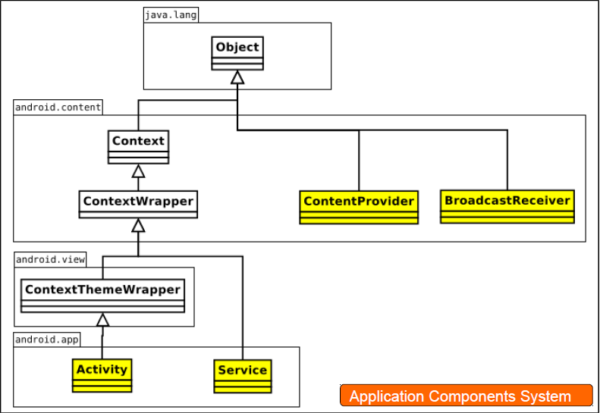
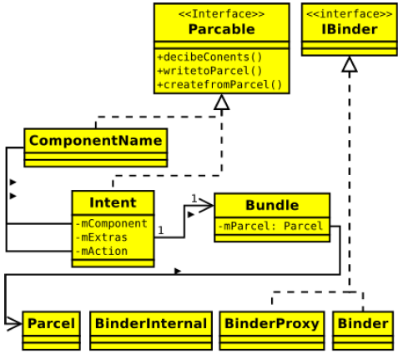
Where does Service Come From
Service extends from Service class and started via Intent (either startService or bindService)
Intent has 1:1 relationship with Bundle that has Parcel in, which can be transacted across process

Slide 36
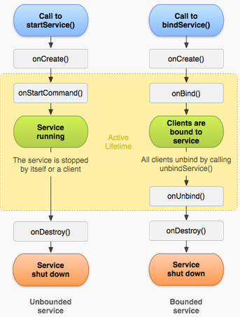
Service Lifecycle
Active
Lifecycle
Entire Lifecycle

Slide 37
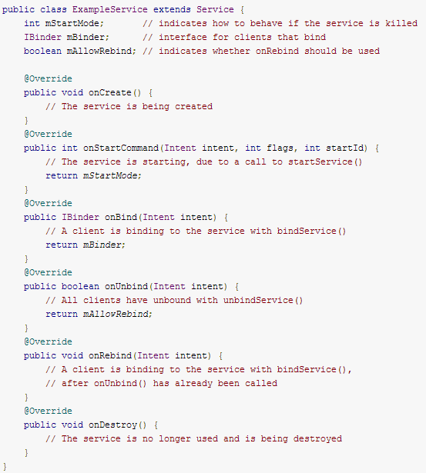
Implementation the Lifecycle Callbakcs
All of them are needed for Bound Service
Return NULL by overriding onBind for Started Service

Slide 38
Avoid Service to be Terminated Unexpectedly
--Foreground process: user interact with
--Visible process: onPause due to dialog popup
--Service process: background, such as playing music
--Background process: onStop, system kill it at any time
--Empty process: hold nothing of application, cache
Actively
onCreate(), onStartCommand(), onDestroy() onBind() cause current service process to be in foreground state
startForeground(int, Notification) to put the started service in a foreground state
Passively
After onStartCommand, current process is treated as Service process, but could be killed when memory is low
After onBind, current service process will at least be guaranteed as the same process ranking of all its clients
--client-F & service-F, client-V & service-V

Slide 39
How to Get Service Restarted
If service is killed while starting it by calling
public int onStartCommand (Intent intent, int flags, int startId)
--Use START_FLAG_RETRY as flag for onStartCommand() , in case of the original attempt never got to or returned from it, possibly the intent is lost
--Use START_FLAG_REDELIVERY as flag for onStartCommand() to avoid intent get lost
if START_REDELIVER_INTENT is returned from onStartCommand() previously
--Simply, you could let your service return START_STICKY from onStartCommand() after service is started

Slide 40
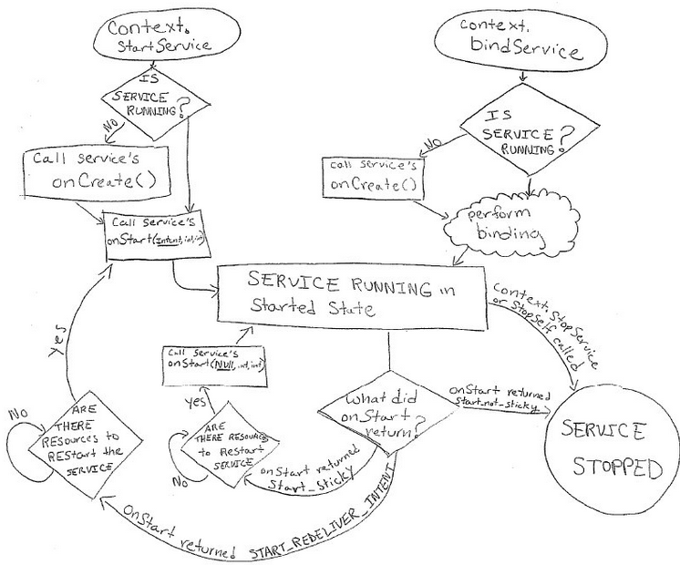
Service Lifecycle In Another View
START_FLAG_REDELIVERY
if this service's process is killed after it is started, then it will be scheduled for a restart and the last delivered Intent re-delivered to it again.
if this service's process is killed after it is started, then leave it in the started state. Later the system will try to re-create the service, because it is in the started state

Slide 41
Started Service @ Opt1
IntentService
--Subclass of Service
--Do NOT need the worker thread (built-in)
--NOT Bound Service

Slide 42
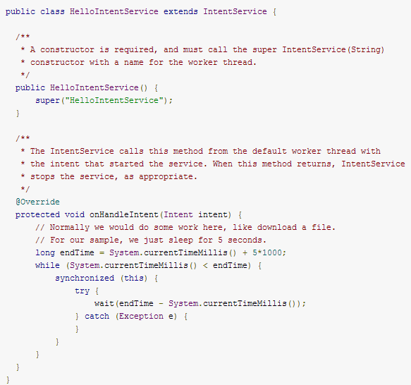
Example: Started Service @ Opt1
Stop service after method returns immediately

Slide 43
Started Service @ Opt2
Service
--Parent class of IntentService
--Need to create worker thread
--NOT Bound Service

Slide 44
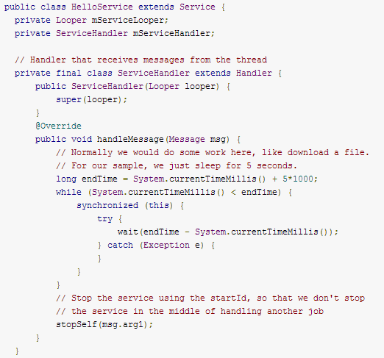
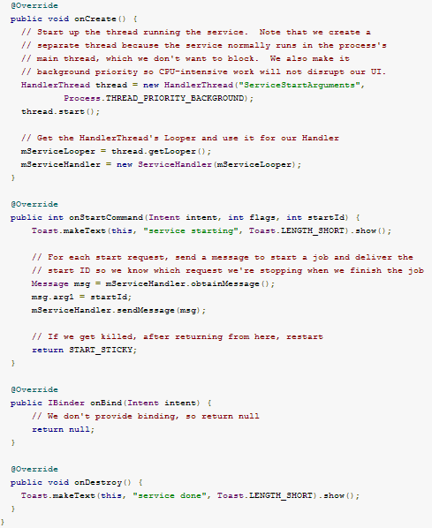
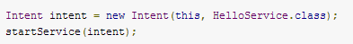
Example: Started Service @ Opt2
New worker thread
New thread handler
Send msg to the thread handler
Stop the service according to request ID
Service only can be communicated with other components of same app
the system first calls onCreate(), then calls onStartCommand()

Slide 45
What Bound Service
It can be applied as Local service upon local binder or Remote service (IPC) upon Messenger or AIDL
In case of IPC:
--handle requests in a msg. queue by single threading (Messenger)
--handle requests simultaneously by multi threading (AIDL)
Lifecycle of Bound Service:
--Typically lives ONLY while it serves others so it does NOT run in the background indefinitely, the system destroys the service when no clients bound to the service, after clients unbind service from server
Use Case:
--Client / Server

Slide 46
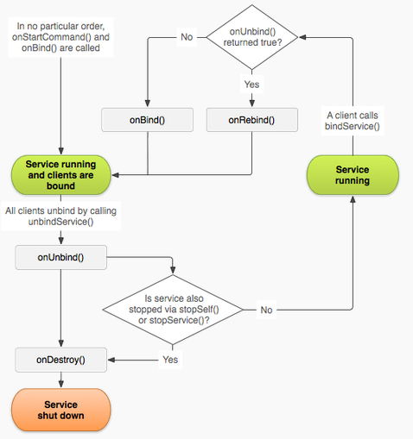
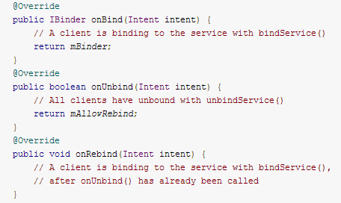
Bound Service Lifecycle Management
Set onUnbind() return TRUE will result in onRebind() will be called in next time when client bind service

Slide 47
Bound Service @ Binder
Extending the Binder class (Local Service / Same Process)
--Service access via service “method”
Key Elements: Local Binder
Use Scenario: Not IPC

Slide 48
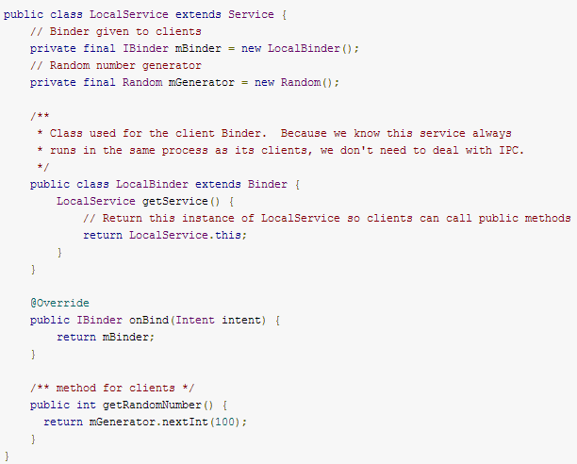
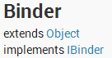
The Service
Service
Return this instance of LocalService so local client can call public methods
Return binder object (local binder)
Service Impl.

Slide 49
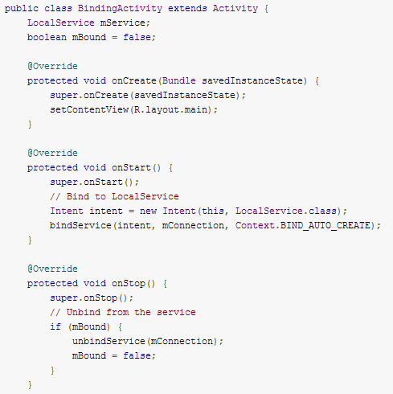
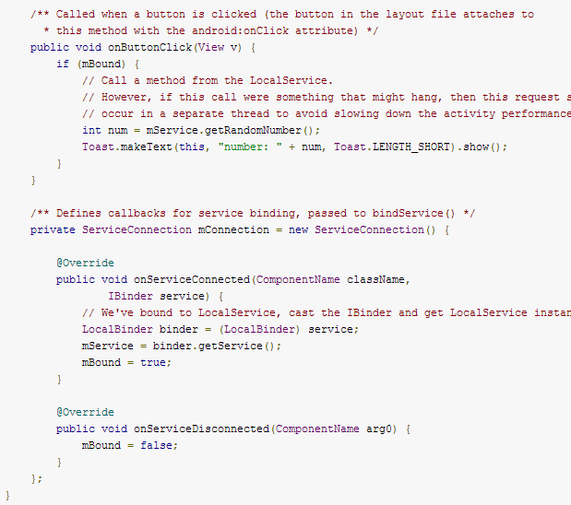
The Client
Client
Use the service
Bind the service
Get the service instance
Unbind the service

Slide 50
Bound Service @ Messenger
Using a Messenger (Remote Service / Across Process / Single Threading)
--Service access via comm. message instead of service “method”
Key Elements:
Messenger (Implement Parcelable) + Handler + Communication Protocol (the msg.)
Use Scenario: IPC + Single Thread (No need to ensure thread-safe)
Note:
Client and Server both needs the Messenger to implement two-way messaging communication

Slide 51
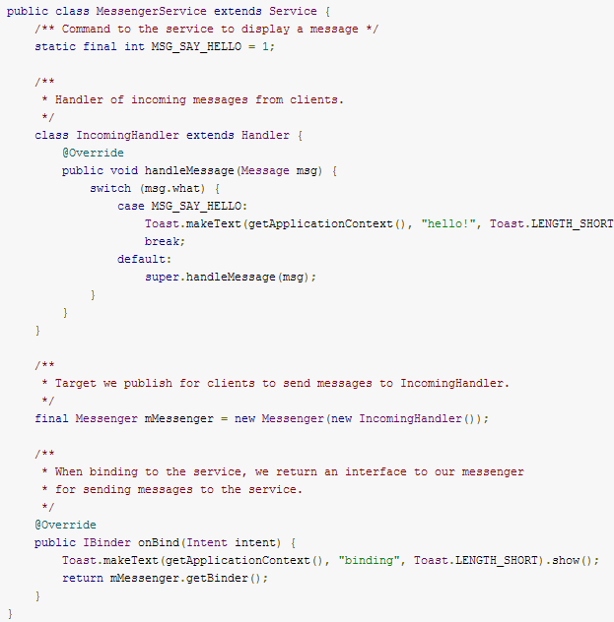
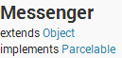
Service
Service
The Handler handle msg. that is sent from client to service via Messenger
Service Impl.
Create a new Messenger pointing to the given Handler.
Return binder object (remote binder)

Slide 52
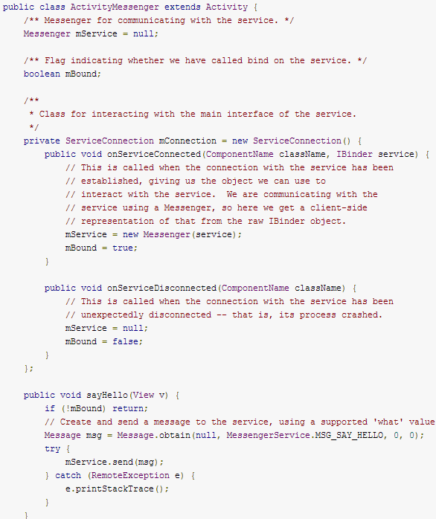
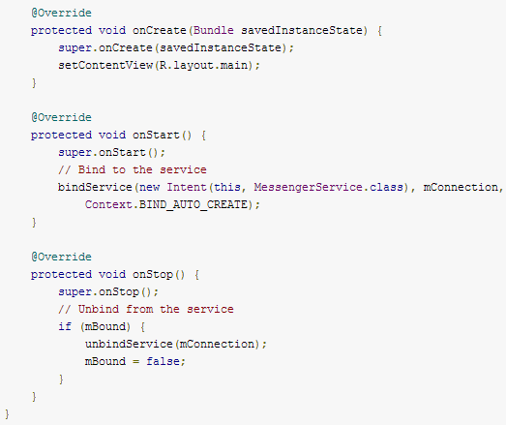
Client
Client
Bind the service
Get remote binder object
Unbind the service
Send msg to service from client upon comm. protocol

Slide 53
AIDL
Using AIDL (Remote Service / Across Process)
--Service access via service “method” defined in AIDL
Key Elements:
AIDL + IService (IService.Stub) + Service Impl. + Service Container
Use Scenario: IPC + Multiple Threads (Need to ensure thread-safe)

Slide 54
What AIDL
AIDL (Android Interface Definition Language) is similar to other IDLs
Allow you to define the programming interface that both the client and service agree upon in order to communicate with each other using IPC.
Enable one process access memory space in another process by
--Marshall the objects across that boundary of process
--Decompose objects into primitives that the operating system can understand

Slide 55
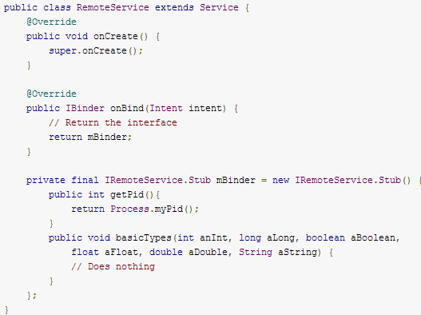
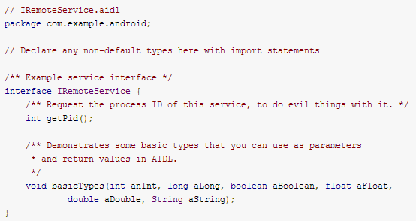
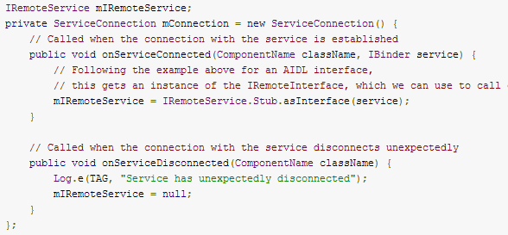
Service & Client
Remoteservice.java
Service
IRemoteservice.aidl
Service AIDL
Return binder object (remote binder)
Service Impl.
the SDK tools generate the IBinder interface class (IRemoteService.java) file in your project's gen/ directory
The generated interface includes a subclass named Stub (IRemoteService.Stub) that is an abstract implementation of its parent interface and declares all the methods from the .aidl file,
In stub, there is a helper method IRemoteService.Stub.asInterface() returns an instance of the stub interface
Client
Get remote binder object
Client app must have a copy of the .aidl file in its src/ directory, if it is NOT running in the same process of service

Slide 56
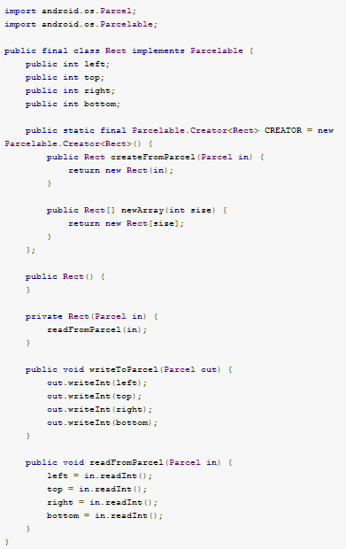
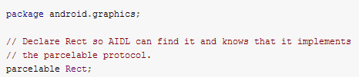
Passing Objects over IPC
Public CREATOR field that generates instances of your Parcelable class from a Parcel.
Transaction data between client and service
Create a new instance of the Parcelable class, instantiating it from the given Parcel whose data had previously been written by Parcelable.writeToParcel().
Create a new array of the Parcelable class.

Slide 57
Best Practice in Bound Service
Bind during onStart() and unbind during onStop()
-- Activity interact with the service while it is visible
Bind during onCreate() and unbind during onDestroy()
--Activity is stopped in the background, so the process ranking is decreased, then system will more likely kill the activity in case of low memory, but it does NOT unbind from bound service, so bound service is never stopped
Bind during onResume() and unbind during onPause()
--Transition of activity cause overhead across process communication

Slide 58
What JNI
Motivation
Where Java alone does not meet the needs of application/service application, then to use the JNI to write Java native methods to handle those situations, such as libraries in Android native
JNI Spec: http://docs.oracle.com/javase/7/docs/technotes/guides/jni/spec/jniTOC.html

Slide 59
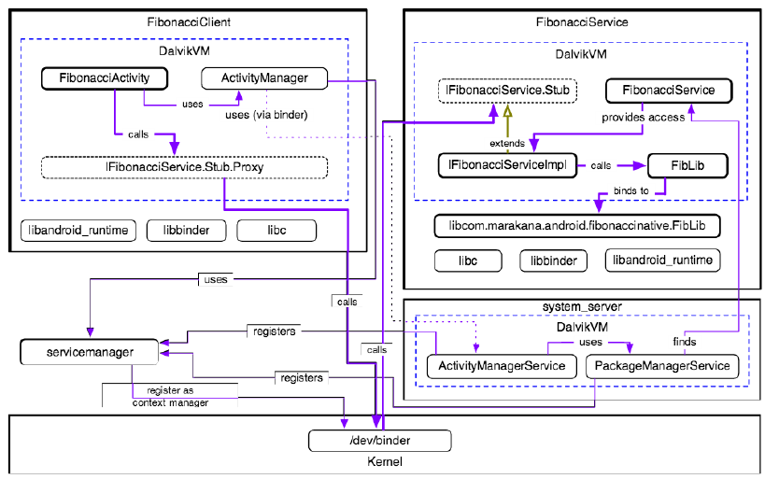
Fibonacci as Bound Service

Slide 60
Fibonacci
To demonstrate a Binder-based service and client (based on Fibonacci), we’ll create three separate projects:
--FibonacciCommon library project - to define our AIDL interface
as well as custom types for input and return
--FibonacciService project - where we implement our AIDL interface and expose it to the clients via Android service component
--FibonacciClient project - where we connect to our AIDL-defined service and use it

Slide 61
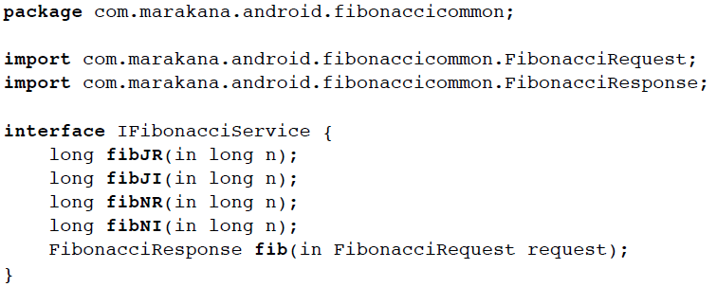
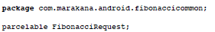
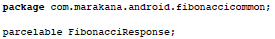
Fibonacci Common AIDL
AIDL
Interface of Fibonacci Service
AIDL
Parcelable is interface, so it should be defined by AIDL also
AIDL

Slide 62
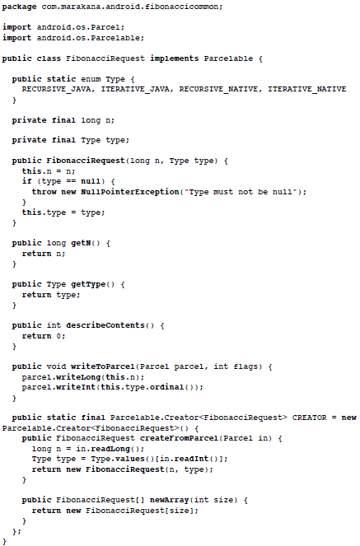
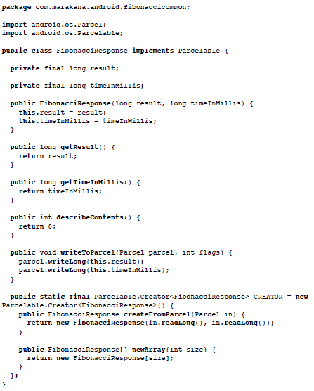
Fibonacci Common @ Request & Response

Slide 63
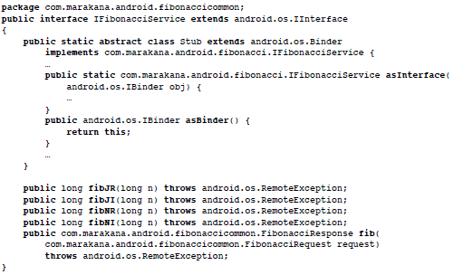
Fibonacci Common @ Generated IService
Subclass that Stub of IService
Remote binder
Method with Type of Return
Method with Type of Input

Slide 64
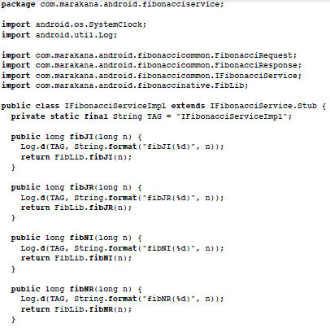
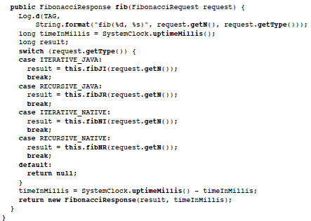
Fibonacci Service @ Service Impl.
Service Impl. IService.Stub
Method impl.

Slide 65
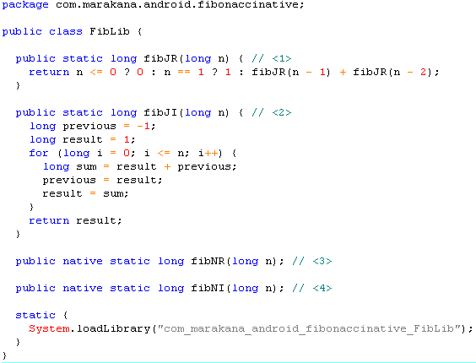
Fibonacci Service @ Service Dependence Lib
Either to implement of the Fibonacci algorithms in Java
Or to implement of the Fibonacci algorithms in Native

Slide 66
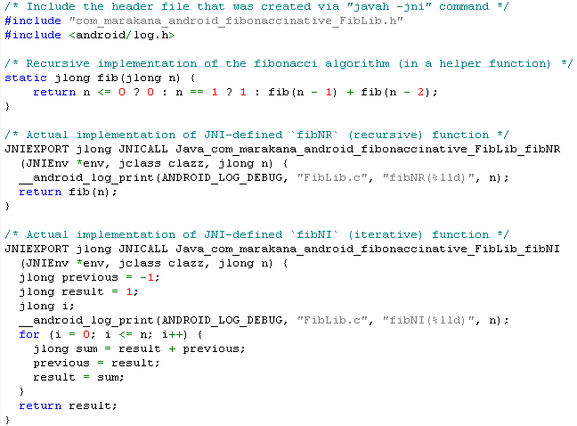
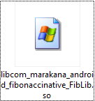
Fibonacci Service @ Service JNI
TIP: run ndk-build under FibonacciService/ in order to generate the required native library

Slide 67
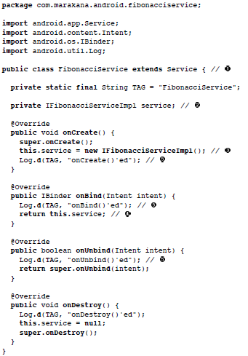
Fibonacci Service @ Service Container
Start Service
Return binder object

Slide 68




Fibonacci Client @ Service Caller
Get remote binder object

Slide 69
Agenda
Service Overview
Process and Thread in Android
Intent and Intent Filter in Android
Started Service and Bound Service
System Service

Slide 70
What System Service
System Services as App FWK
--Either App proactively invoke system services with services instance return from Context.getSystemService, such as LocationManager, which are pre-defined services and exposed via ServiceManager.
--Or App is passively scheduled/monitored by system service, such as ActivityManager, etc

Slide 71

Where are System Services Running
The system server is started as soon as Dalvik is initialized and running in boot sequence.
The other system services will be running in the context of the System Server process.

Slide 72

Where are All System Services
frameworks/base/services/core/
Not Up-to-date

Slide 73




How System Server is Started
/frameworks/base/services/java/com/android/server/SystemServer.java
SystemServiceManager starts services NOT for app
Entry for zygote
Add services to ServiceManager for app
Create ServiceManager

Slide 74
What ServiceManager
Java SM Wrapper: /frameworks/base/core/java/android/os/ServiceManager.java
Java SM Interface: /frameworks/base/core/java/android/os/IServiceManager.java
Java SM Binder: /frameworks/base/core/java/android/os/ServiceManagerNative.java
Native SM Binder: /frameworks/native/libs/binder/IServiceManager.cpp

Slide 75

Look Back to ServiceManager
/frameworks/base/core/java/android/os/
/frameworks/native/libs/binder/

Slide 76
Add Service to System Server
Add the AIDL interface to the build system /frameworks/base/Android.mk
Implement service (based on AIDL)
/frameworks/base/services/core/java/com/android/server/
Call on native “driver” code through JNI if needed
/frameworks/base/services/core/jni/
Start service in system server
/frameworks/base/services/java/com/android/server/SystemServer.java
Add service to ServiceManager
/frameworks/base/services/java/com/android/server/SystemServer.java
Service could be called by Client now

Slide 77
Reference
http://developer.android.com
http://elinux.org/Android_Binder
http://en.wikipedia.org/wiki/
http://www.vogella.com/articles/AndroidServices/article.html
http://events.linuxfoundation.org/

